Slide 1
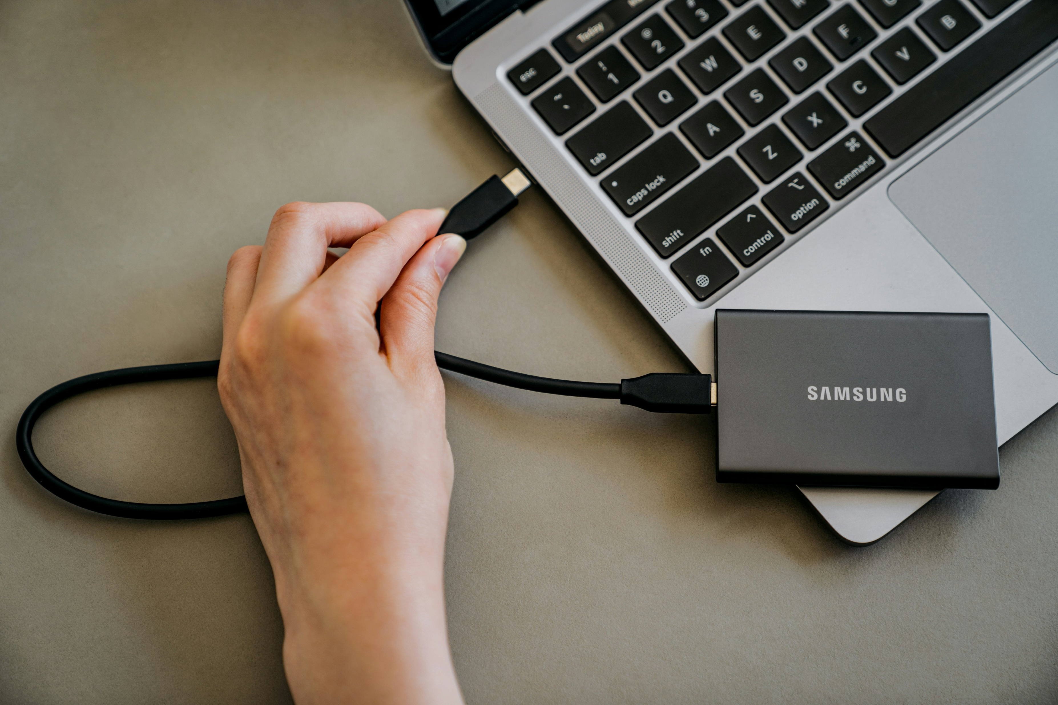
冒險故事 (Animaze)
Notes:
https://unsplash.com/photos/a-person-is-plugging-a-charger-into-a-laptop-ow8IIlkzbUw

Slide 2
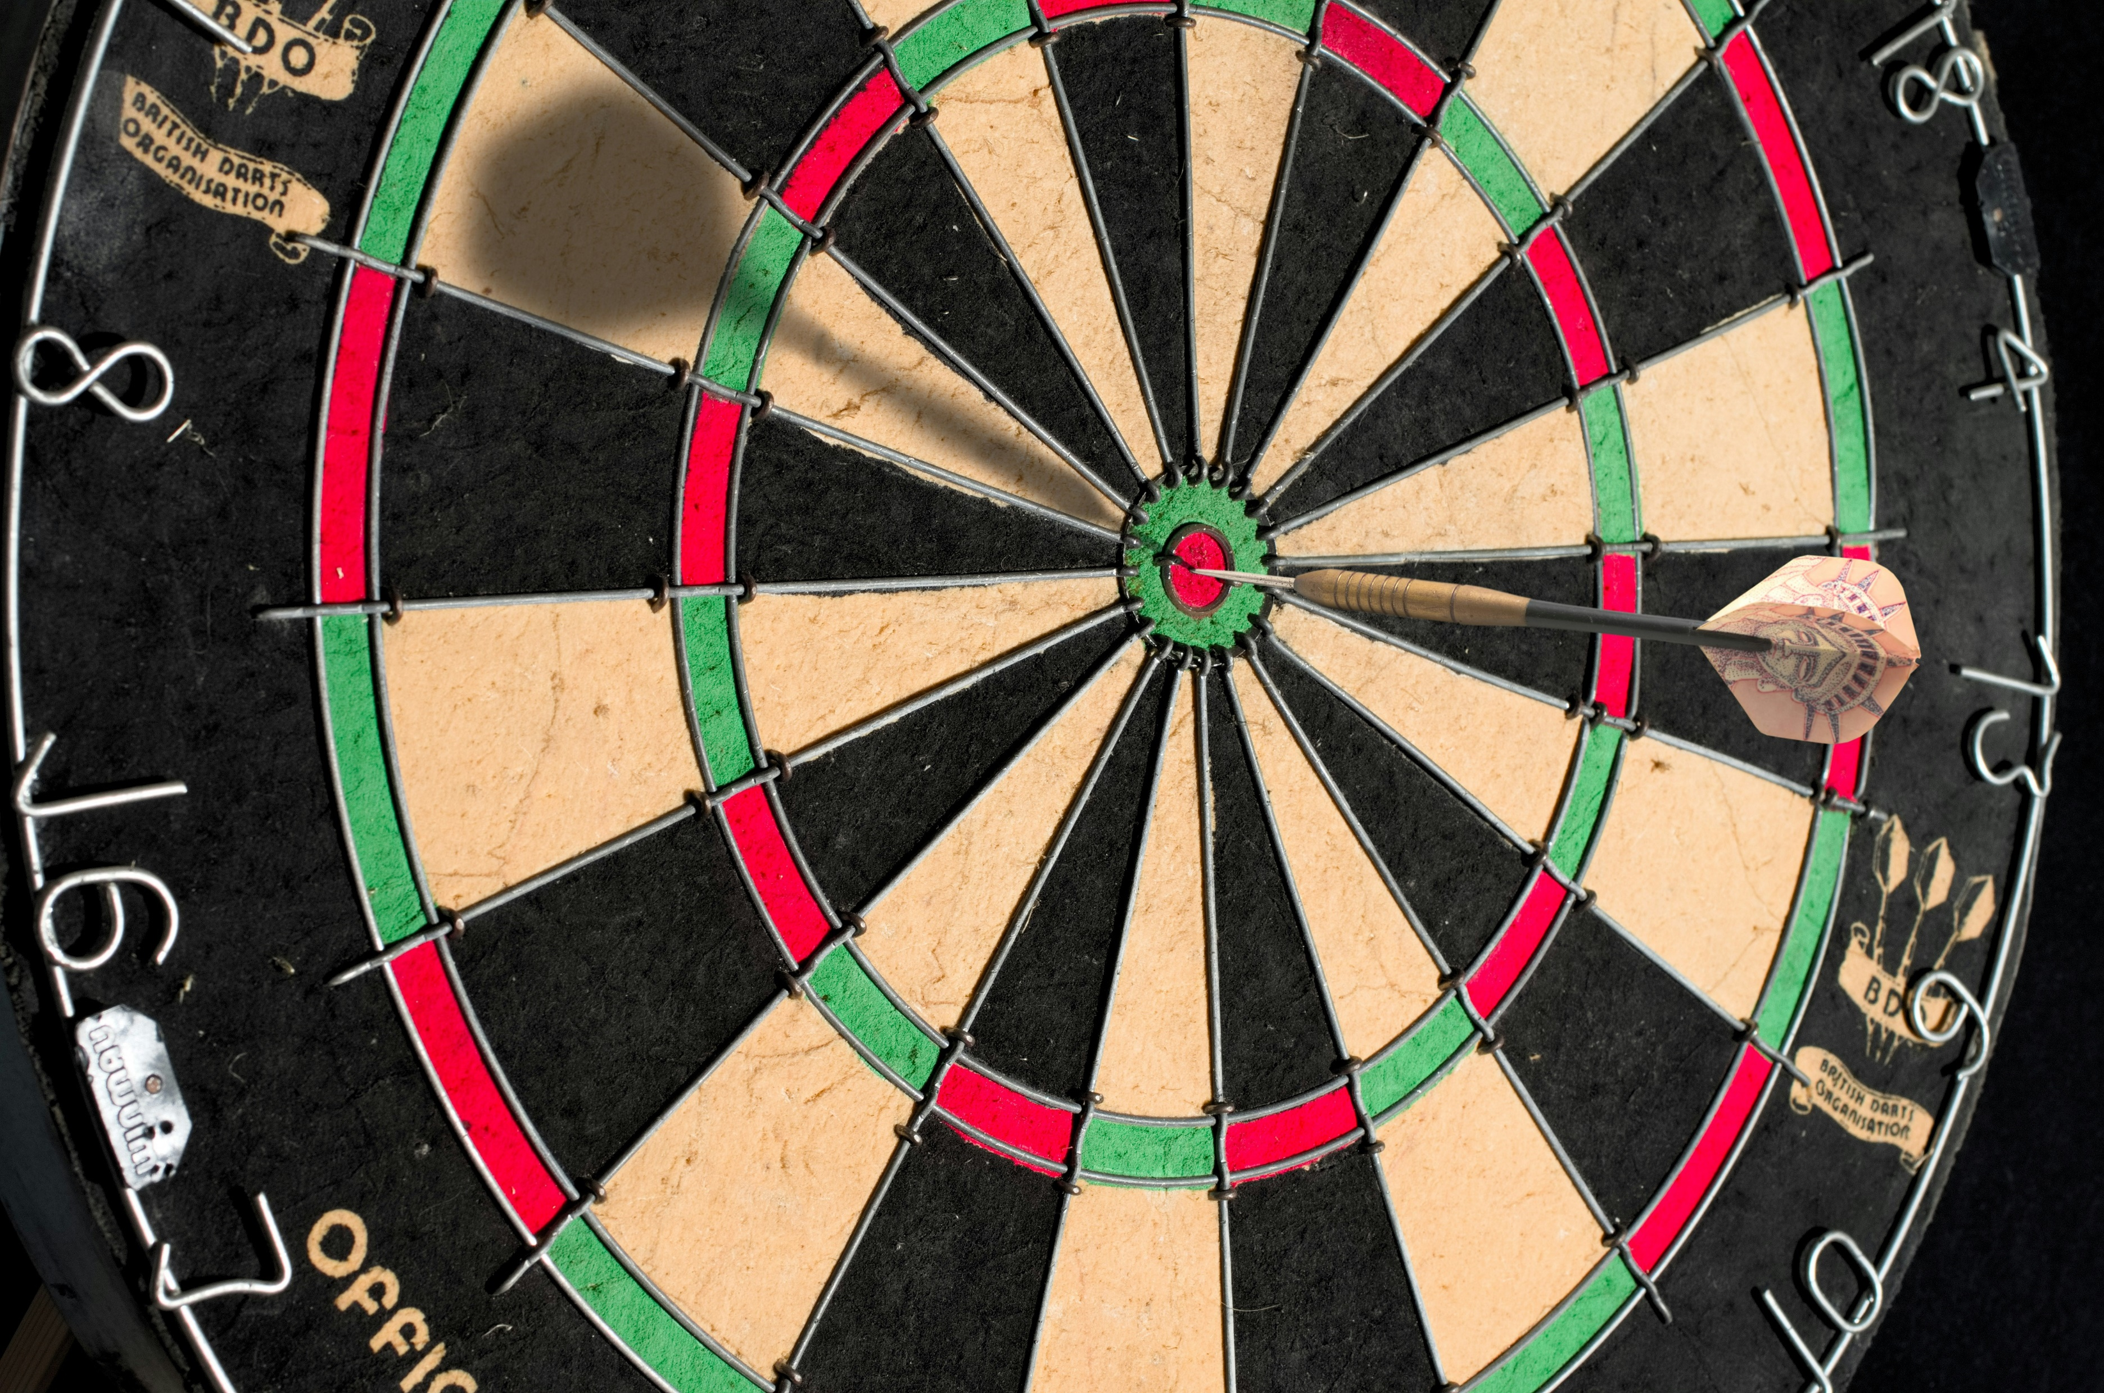
1.目標
Notes:
https://unsplash.com/photos/brown-and-black-round-board-DX3_dXuHVl8

Slide 3

Notes:
https://unsplash.com/photos/woman-placing-sticky-notes-on-wall-Oalh2MojUuk

Slide 4
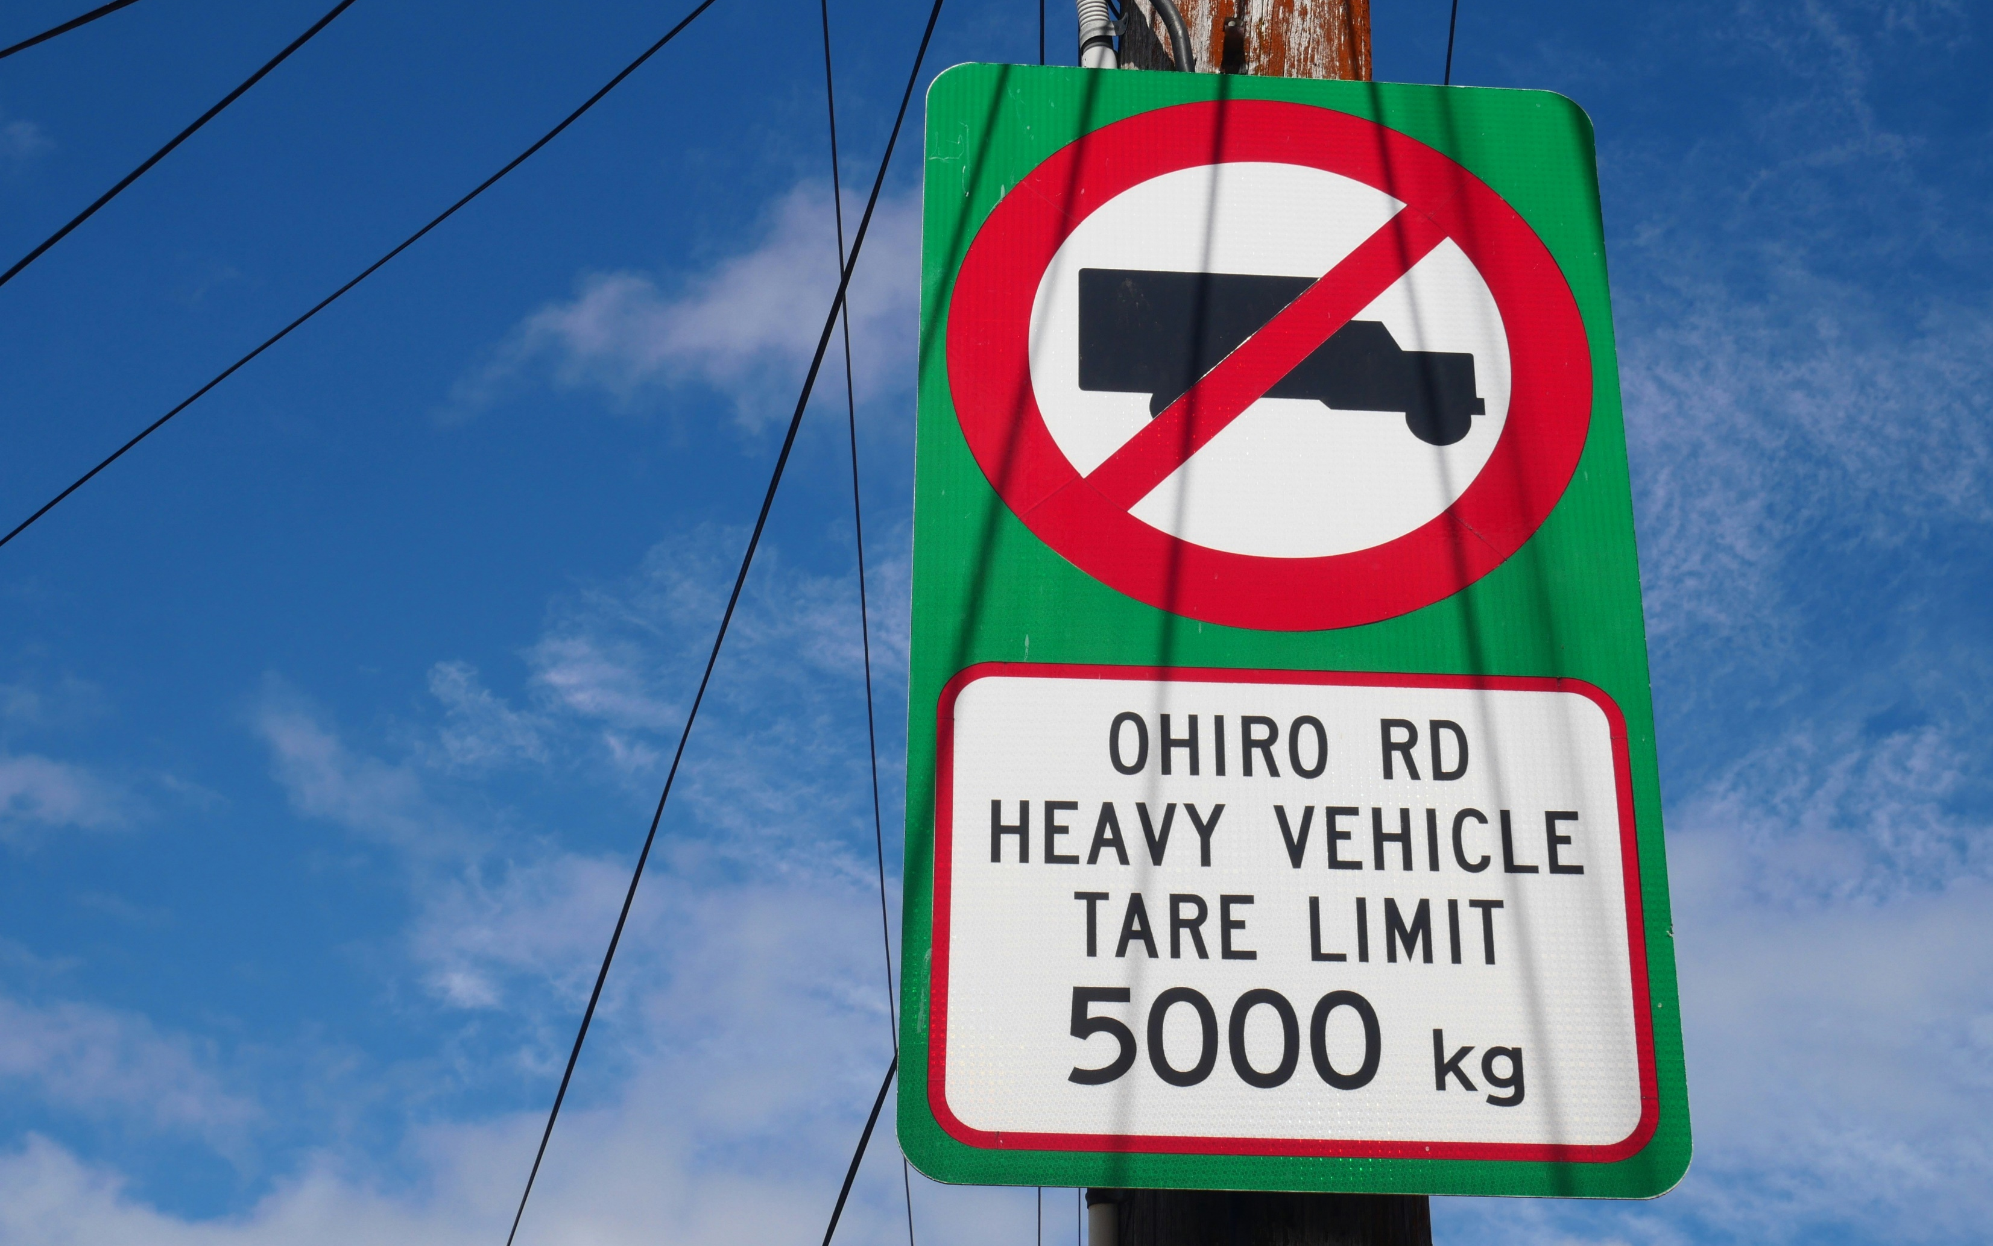
2. 阻礙
Notes:
https://unsplash.com/photos/a-sign-on-a-pole-53WkEqcrntA

Slide 5
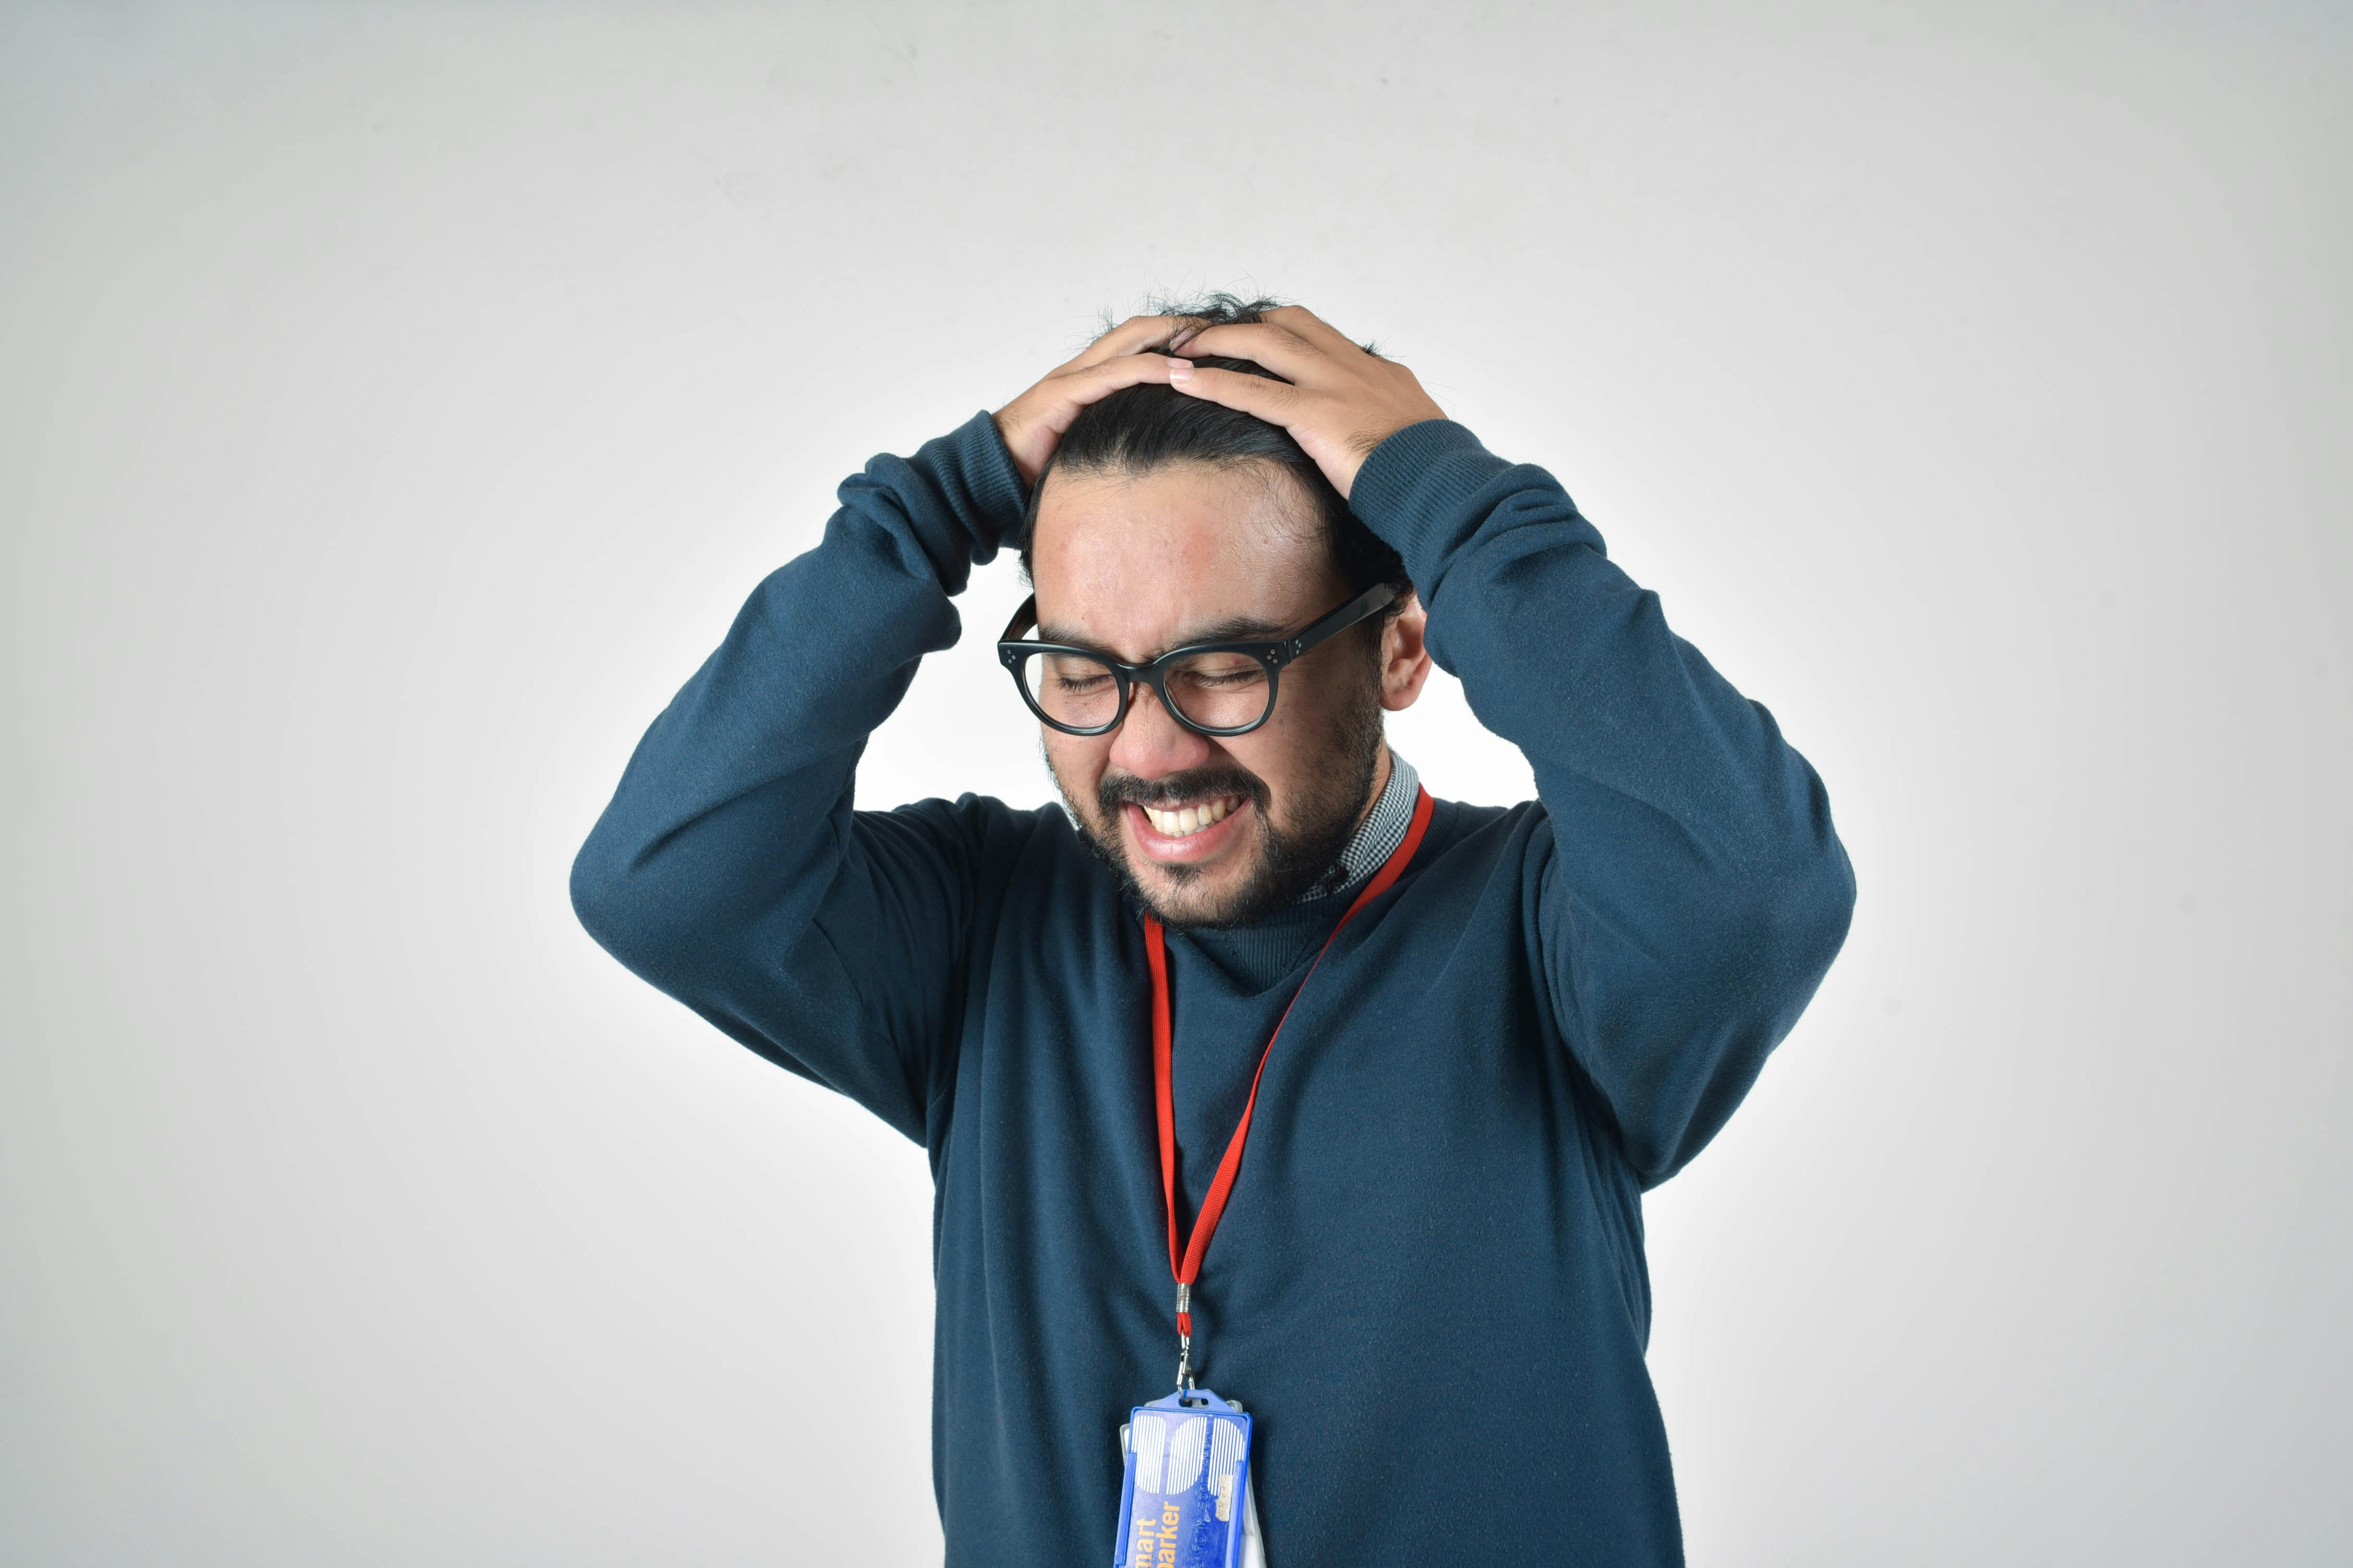
Notes:
https://unsplash.com/photos/man-in-bluee-ssweater-OupUvbC_TEY

Slide 6

3.努力
Notes:
https://unsplash.com/photos/man-in-black-tank-top-and-gray-pants-jkUVJi6rHUM

Slide 7
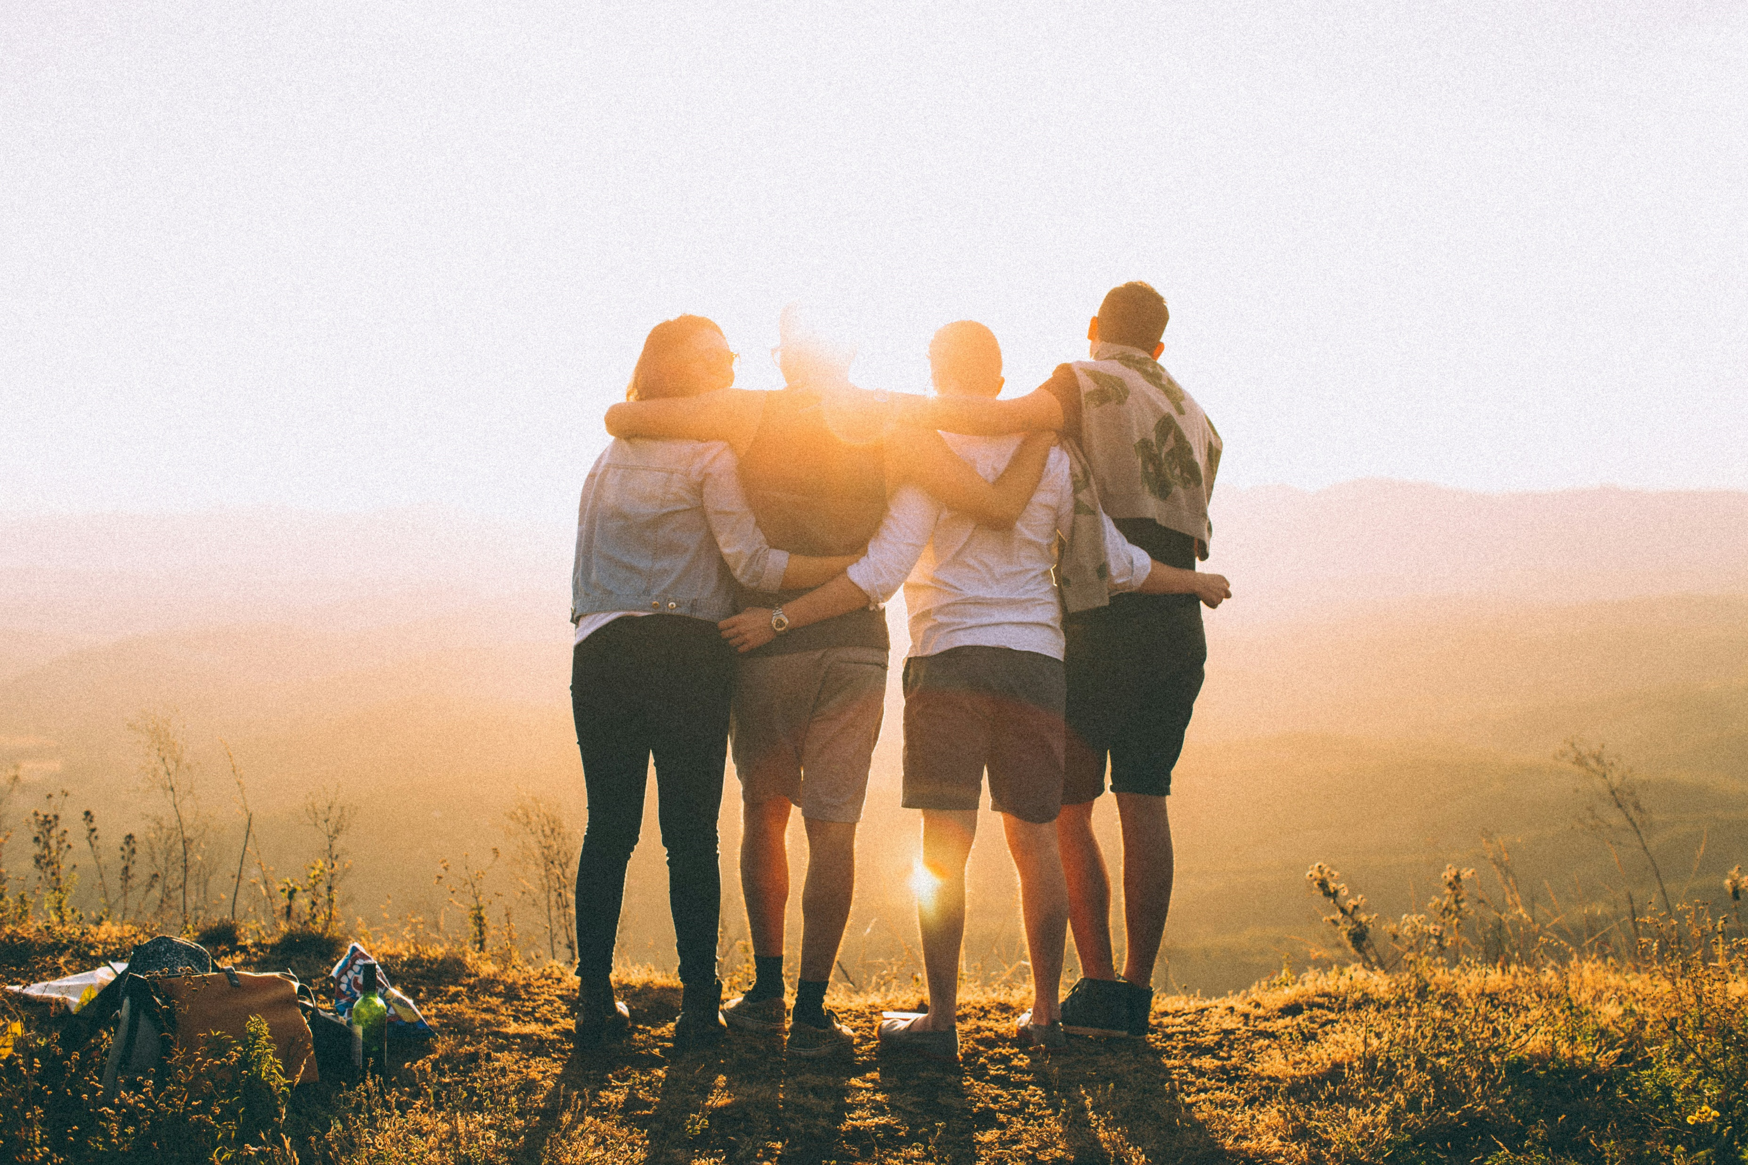
Notes:
https://unsplash.com/photos/four-person-hands-wrap-around-shoulders-while-looking-at-sunset-PGnqT0rXWLs

Slide 8

4.結果
Notes:
https://unsplash.com/photos/a-person-is-writing-on-a-piece-of-paper-ykgLX_CwtDw

Slide 9
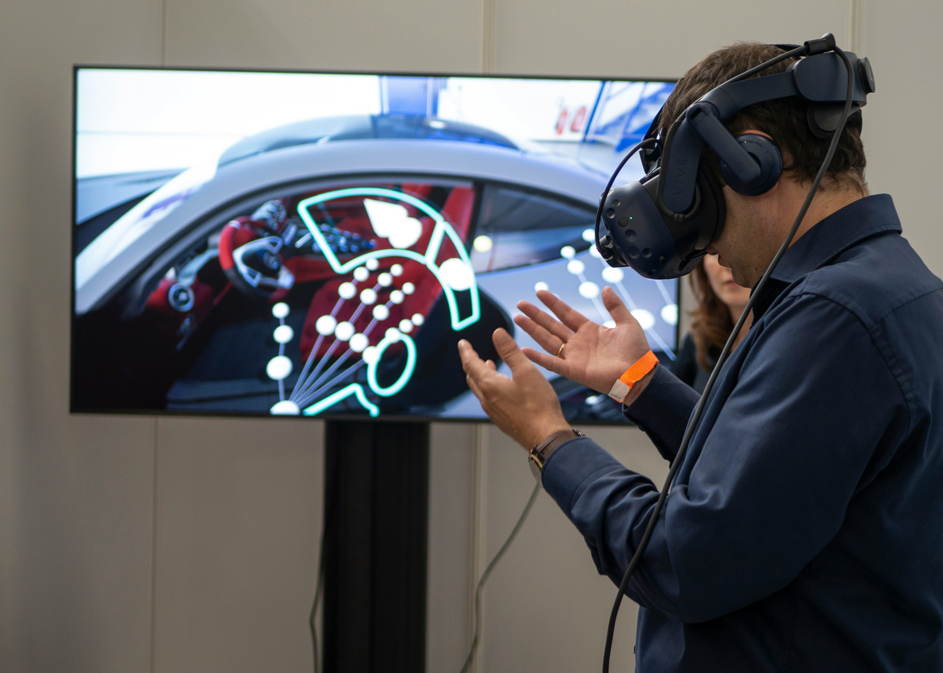
Notes:
https://unsplash.com/photos/man-in-black-jacket-holding-blue-and-white-plastic-cup-ipDhOQ5gtEk

Slide 10
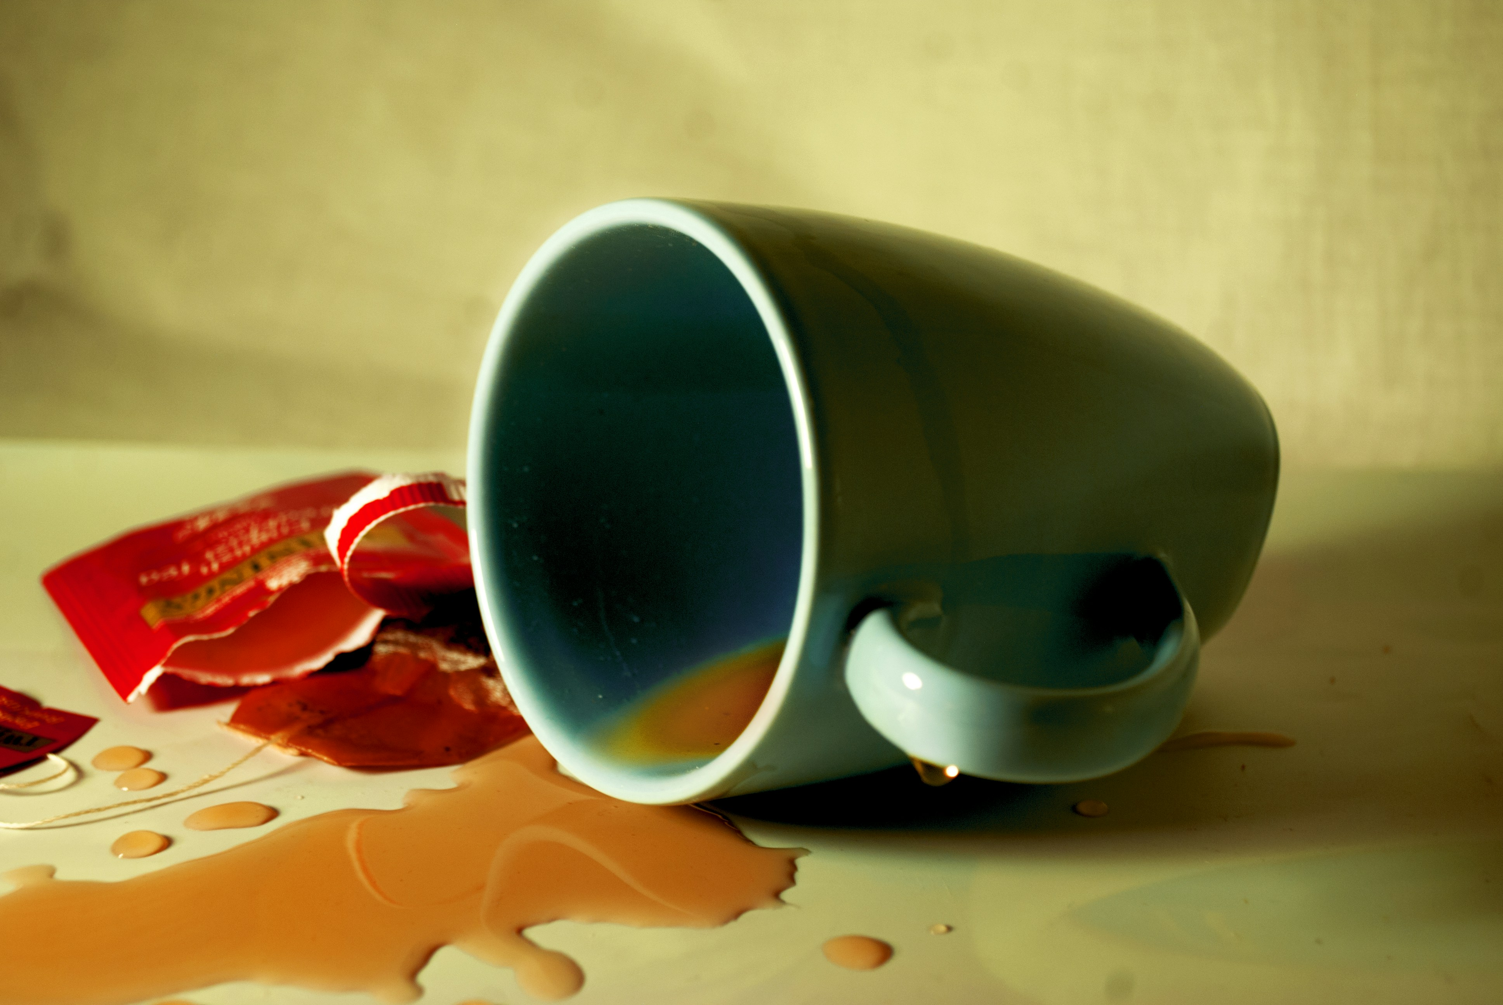
5.意外
Notes:
https://unsplash.com/photos/a-coffee-cup-spilled-on-a-table-oSOY6Ozl6T0

Slide 11

Notes:
https://unsplash.com/photos/woman-sitting-on-floor-wearing-brown-dress-VzqEavUGnss

Slide 12
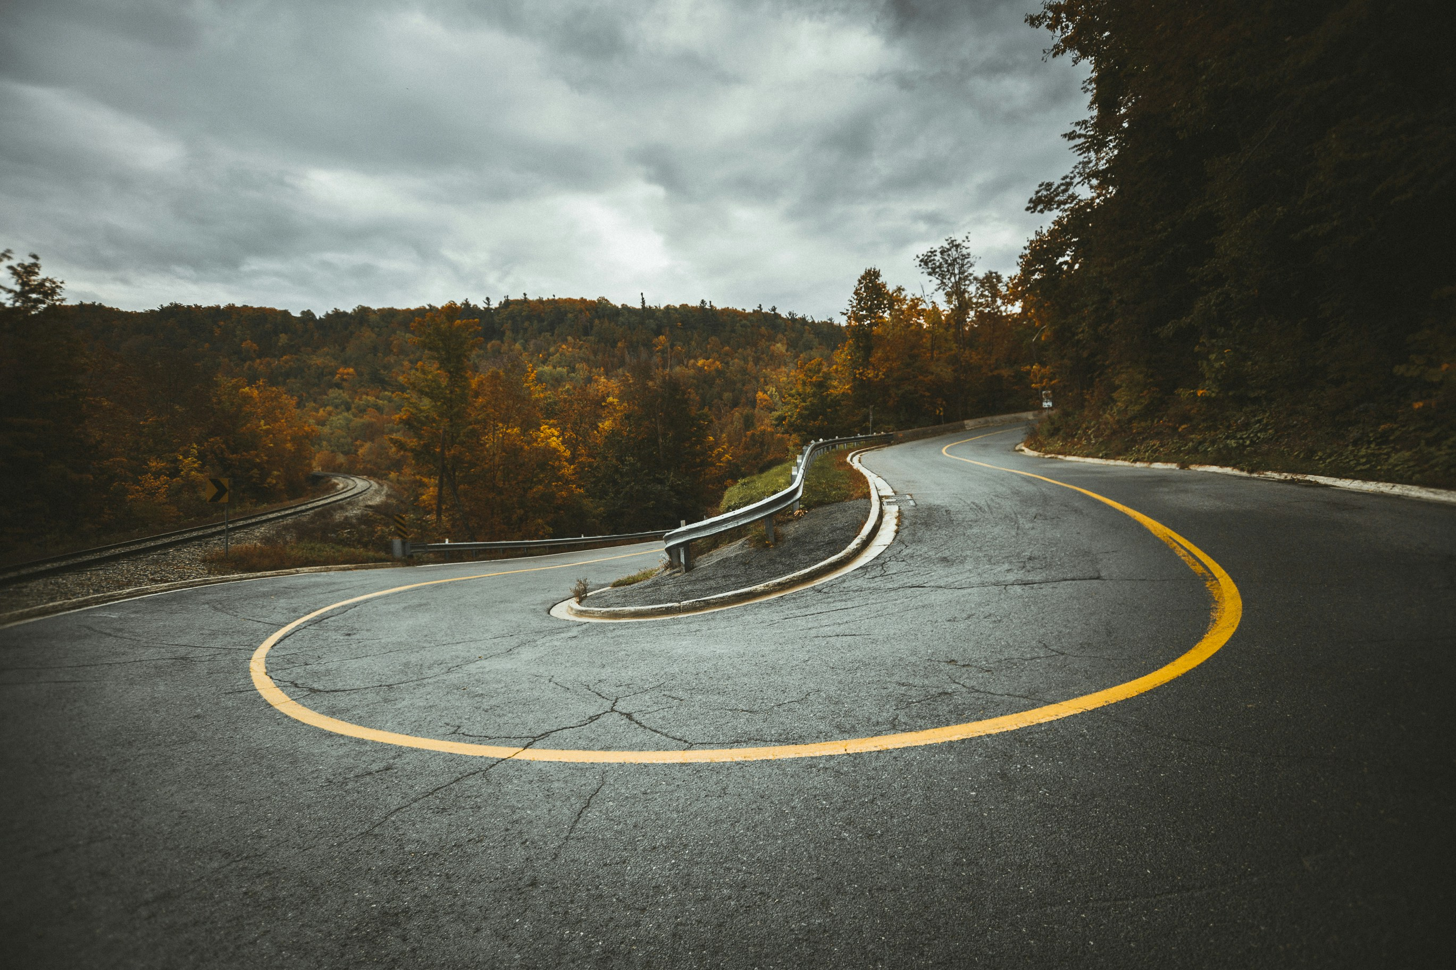
6.轉彎
Notes:
https://unsplash.com/photos/aerial-view-of-highway-near-trees-UOa7TTCyxME

Slide 13
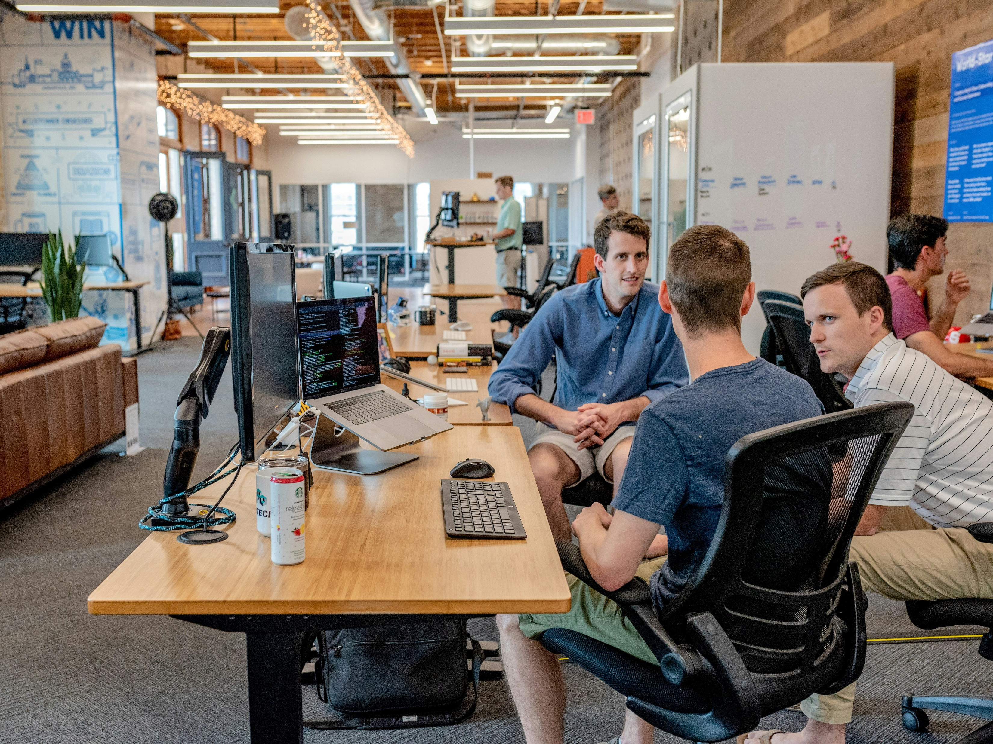
Notes:
https://unsplash.com/photos/three-men-sitting-on-chair-beside-tables-mpN7xjKQ_Ns

Slide 14
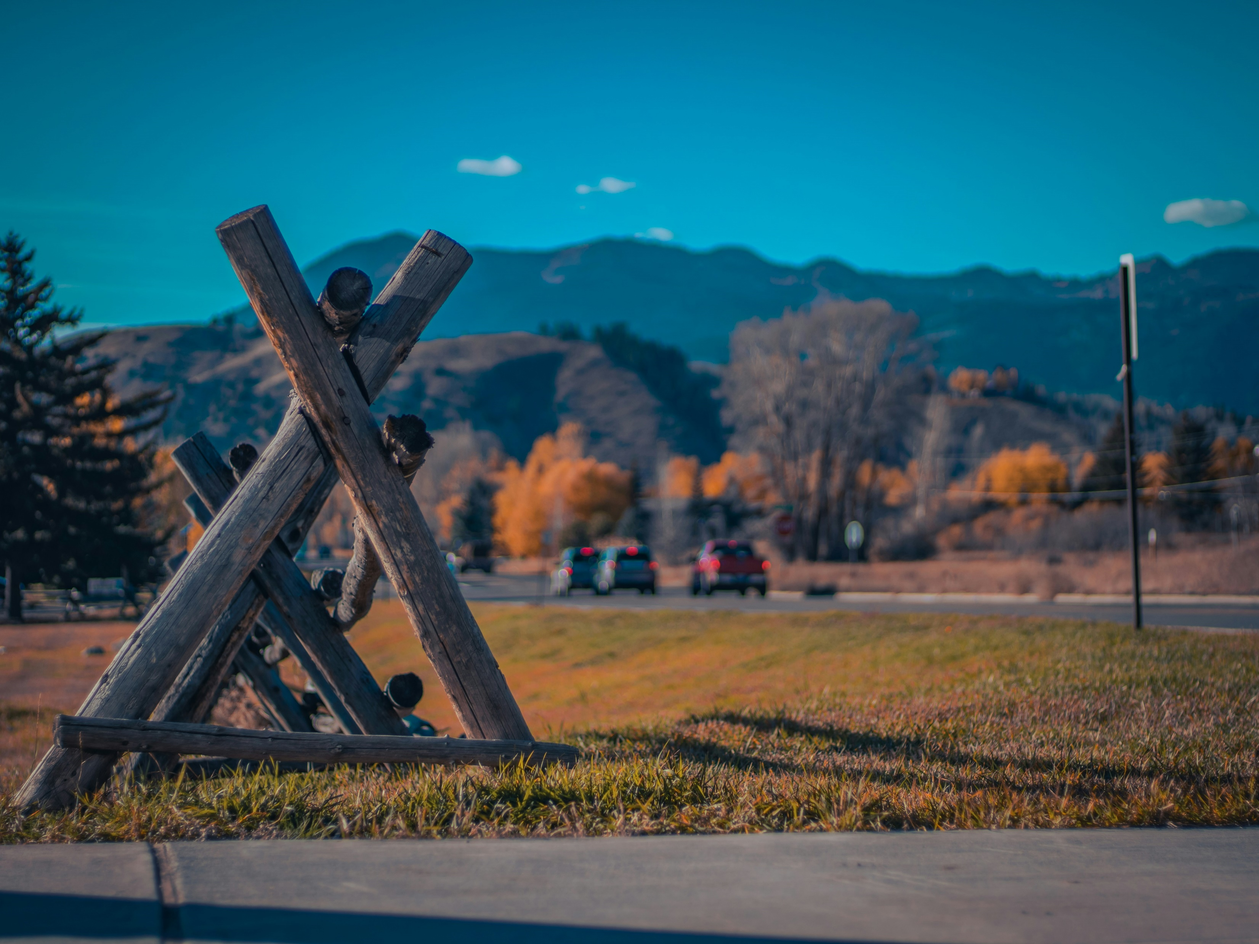
7.結局
Notes:
https://unsplash.com/photos/a-wooden-structure-sitting-on-the-side-of-a-road-ATqGYfSvbgQ

Slide 15

Notes:
https://unsplash.com/photos/man-standing-near-high-rise-building-GzumspFznSE

